Slide 1


Molecular dynamics analysis libraries, part 2 with an example based on the dynamics in the physiopathology of gelsolin
Toni Giorgino toni.giorgino@cnr.it
www.giorginolab.it
@giorginolab
Master projects available!
MSI - Master in Bioinformatics for Health Sciences @ UPF 24/4/2020
Notes:
1

Slide 2

Part 1. Finnish-type amyloidogenic gelsolin variant -
an example of protein dynamics playing a role in proteotoxicity and drug design discovered by MD.
Part II.
MD analysis libraries: intro and reproduction of the analysis* shown in the paper.
* Marked with this symbol →

Slide 3
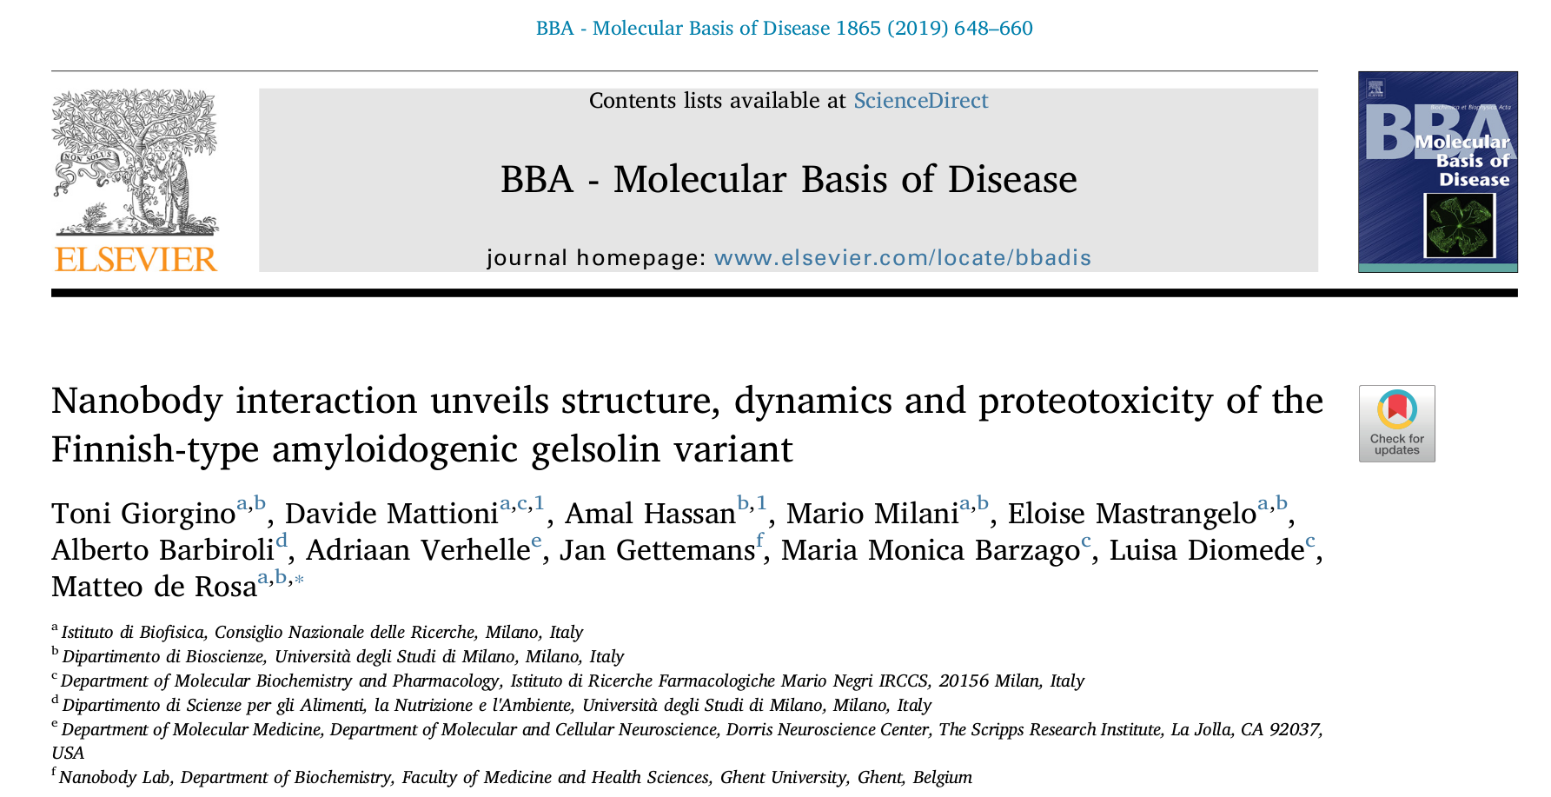
Giorgino T, Mattioni D, Hassan A, Milani M, Mastrangelo E, Barbiroli A, et al. Nanobody interaction unveils structure, dynamics and proteotoxicity of the Finnish-type amyloidogenic gelsolin variant. Biochimica et Biophysica Acta (BBA) - Molecular Basis of Disease. 2019 Mar 1;1865(3):648–60.
Journal link. Preprint.

Slide 4
Part II.
MD analysis libraries
(Practice)

Slide 5
Analysis of MD trajectories
Interactive: VMD, Chimera, PyMol…
Intuitive
Suitable for one-off tasks
Scripted: for…
repeated analysis (e.g. ensembles)
custom tasks (your own ideas)
automated analysis, e.g. machine learning
Analysis libraries are needed

Slide 6
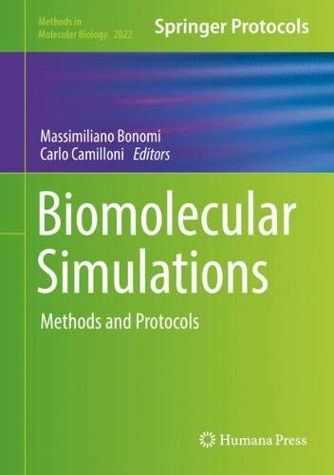
Springer, ISBN 978-1-4939-9608-7 Preprint here.

Slide 7
MD analysis libraries
Library | Language
VMD | TCL
Bio3D | R
MDAnalysis | Python
MDTraj | Python
HTMD/MoleculeKit | Python
We’ll show examples for HTMD, but there are direct equivalents in the others.
In fact, converting is a useful exercise.
See the Chapter.

Slide 8
MoleculeKit*
* part of HTMD
https://github.com/Acellera/moleculekit

Slide 9

Please clone or download…
github.com/giorginolab/GSN-Tutorial-BCN-2020
which contains the papers and data files.
2. Open the Colaboratory link
It is a “live” Python notebook to run your code on Google’s servers. (Account needed)
Alternatively, work locally on your PC.

Slide 10
Loading a trajectory
First, import (activate) the library
Then, load the topology and trajectory*
* Atom names, types, bonds, etc. Usually a PDB or PSF file.
Several formats are supported. Here we use PDB+XTC.

Slide 11
Access molecular data

Slide 12
Access molecular data

Slide 13
Selections
*
* This library uses VMD-like atom selection strings

Slide 14
Filters
Make a duplicate
Keep backbone only
Keep frame 0 only
Write resulting PDB file

Slide 15
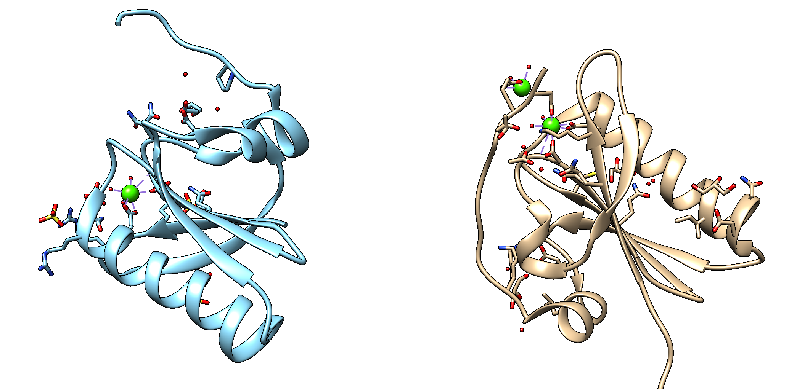
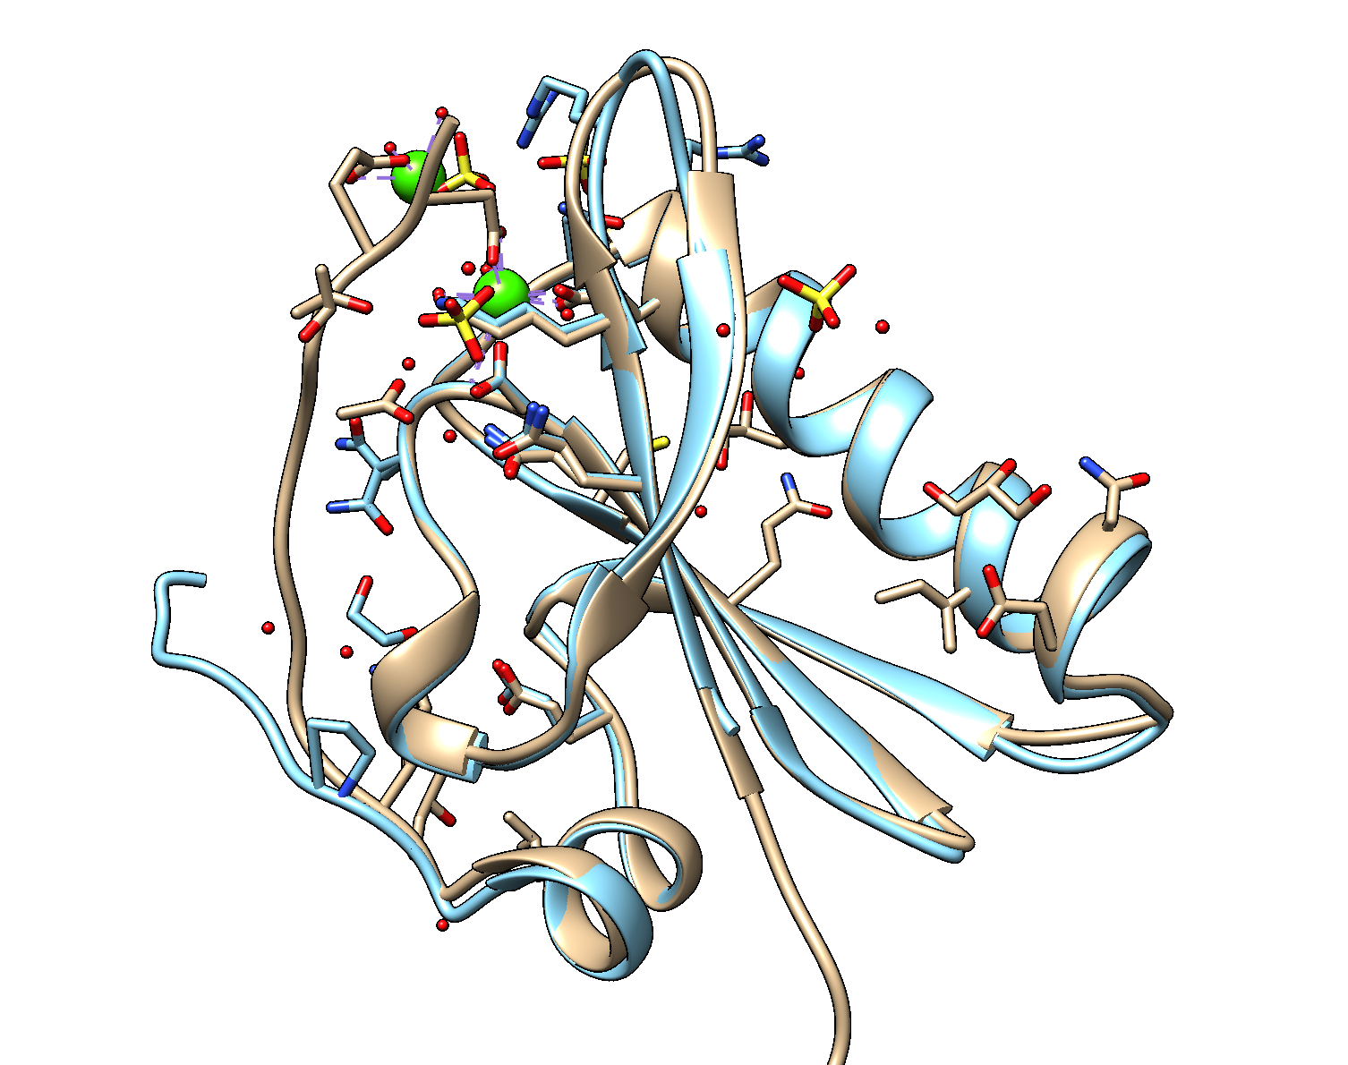
Alignment
Calculations are often performed after a rigid transformation which optimally superimposes two structures (or two frames). It removes diffusion.
Minimize RMSD
Before
After

Slide 16
RMSD
Is the mean squared displacement between two sets of atoms
moleculekit.util.molRMSD(mol, refmol, rmsdsel1, rmsdsel2)
Must have the same number of atoms

Slide 17
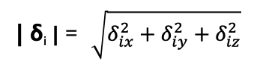
RMSD
Coordinates array: coords[ atom_index , axis , frame ]
δ₀
c[0,:,t]
Atom 0
c[0,:,0]
δ_{i} = c[:,:,t]-c[:,:,0] (vectors)
δ₁
c[1,:,t]
Atom 1
| δ_{i} | = $\sqrt{δ_{ix}^{2}+δ_{iy}^{2}+δ_{iz}^{2}}$
c[1,:,0]
Atom 2
δ₂
c[2,:,0]
c[2,:,t]
= Time 0
= Time t

Slide 18
Data files (directory data)
 | Apo form | In complex with nanobody Nb11
Wild type | WT | WT+Nb
D187N mutant | D187N | D187N+Nb
For each combination you will find:
a PDB file
a PSF file
an unwrapped trajectory in XTC format (1 ns/frame)
IF present, Nb was held restrained

Slide 19
Useful for RMSD-based calculations
MoleculeKit has ready-made projections
MetricRmsd
from moleculekit.projections.metricrmsd import *
https://software.acellera.com/docs/latest/moleculekit/moleculekit.projections.metricrmsd.html
MetricFluctuation
from moleculekit.projections.metricfluctuation import *
https://software.acellera.com/docs/latest/moleculekit/moleculekit.projections.metricfluctuation.html

Slide 20
Now we open the Colaboratory Notebook and attempt to solve the exercises. ☺
Notes:
https://colab.research.google.com/drive/1Pt9gGqiGtrA9_5VRr4J7h3D_WLrBK4k8#scrollTo=SBPzAT4qCrW1

